Slide 1


Mahimai Raja J
30.12.2022

Slide 2

Outline
Executive Summary
Introduction
Methodology
Results
Conclusion
Appendix

Slide 3
Executive Summary
The data is collecting using web scrapping technique in python. Then the missing data is filled appropriately using the central tendency measures. After data is cleaning perfectly the data is visualized using folium library. The the hyperparameters were computed using Grid Search CV. Then multiple machine learning models were comparatively evaluated based on the performance.
Using the real time dashboard by plotly dash we can clearly understand the story of the data. The interactive dashboard enables the user to understand the data in visual manner. Using multiple models on our data we can understand its nature. And finally we can come up with logistic regression as the best model of now with 84% training accuracy and 83%testing accuracy.

Slide 4
Introduction
The project is to make predict whether the spacecraft will successfully launch or not. So that we are making our own data from internet using web scrapping with the help of beautiful soup in python. Then we prepared and processed the data. Then we compared by building multiple models using the graph and measured the performance.
So using best model we are going to predict whether the spacecraft with the given environment condition will launch successfully or not.

Slide 5

Section 1

Slide 6
Methodology
Executive Summary
Data collection methodology:
The data is collected using beautiful-soup in python.
Perform data wrangling
The missing data is imputed using appropriate central tendency measures. Categorical variables are transformed using one-hot encoding. Then all the values were standardized using min-max scalar method.
Perform exploratory data analysis (EDA) using visualization and SQL
The data from the database db2 is analyzed using magic sql on jupyter notebook.

Slide 7
Perform interactive visual analytics using Folium and Plotly Dash
The data is visualized using plotly dash a interactive dashboard in python.
Perform predictive analysis using classification models
Based on the data selectively four model were test on the data and analysed with its performance over the testing and training data.

Slide 8
Data Collection
Data collection is the process of gathering and measuring information on target variables in a established system, which then enables one to answer relevant questions and evaluate o
In this project I have two methods to collect the spacex data by web scrapping and using the spacex api.
I have attached the methodology and flow chart of the data collection process below.

Slide 9
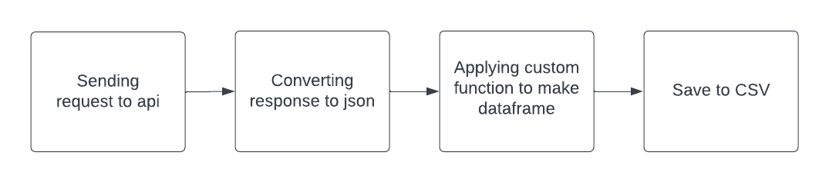
Data Collection – SpaceX API
Send request to the spacex api and store and response in json file. Then process the json with custom functions to make a dataframe and store it in csv.
Github Link : https://github.com/mahimai-raja/project-spacex/blob/main/Week-01/notebookOne.ipynb

Slide 10
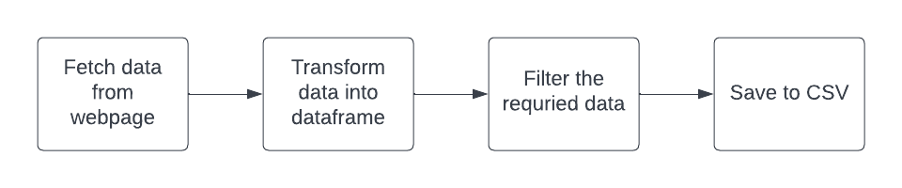
Data Collection - Scraping
Data from the Wikipedia page is fetched using beautifulsoup and then converted into data frame and stored in the CSV.
Github Link : https://github.com/mahimai-raja/project-spacex/blob/main/Week-01/notebookOne.ipynb

Slide 11
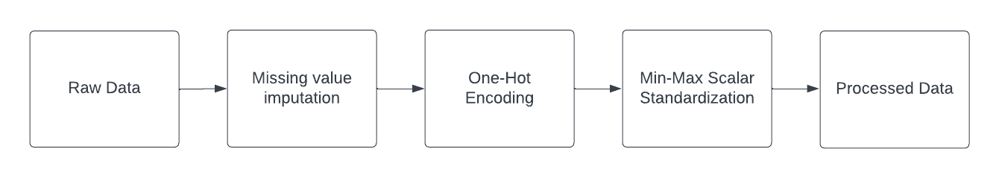
Data Wrangling
The missing data is filled appropriately using central tendency methods. The categorical values are converted into numerical values using one-hot encoding. Then all the records were standardized using min-max scalar method.
Github link : https://github.com/mahimai-raja/project-spacex/blob/main/Week-02/exploratoryDA.ipynb

Slide 12
EDA with Data Visualization
I have scatter plot to find the correlation of data. And used barchart to visualize the categorical variables. I have used line plot to visualize the time defined features.
Github url : https://github.com/mahimai-raja/project-spacex/blob/main/Week-02/dataVisualization.ipynb

Slide 13
EDA with SQL
Used Select query to retrieve the data.
Used Where clause to filter the required data.
Used string operators such as ‘%’ and ‘_’
Github Link : https://github.com/mahimai-raja/project-spacex/blob/main/Week-02/exploratoryDA.ipynb

Slide 14
Build an Interactive Map with Folium
Markers – Used to identify the location easily.
Circle – Used to cluster a group of markers.
Line – Used to measure distance visually in a map.
The visual representation of the location using folium map is used to understand the spread of launch station and its significance.
Github Link : https://github.com/mahimai-raja/project-spacex/blob/main/Week-03/site_location_folium_maps.ipynb

Slide 15
Build a Dashboard with Plotly Dash
I have used pie chart and scatter plot to visualize the given data interactively using dash library in python.
The pie chart is used to represent the proportional ration of the sample data. And scatter plot helps to identify the correlation between the attributes.
Github Link : https://github.com/mahimai-raja/project-spacex/tree/main/Week-03/plotlyDashboard

Slide 16
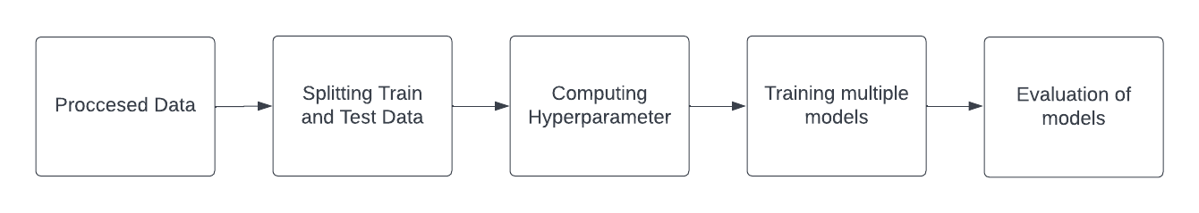
Predictive Analysis (Classification)
The processing data is splitted into training and testing data. Then using grid search cv hyperparameters were computed. The multiple models were trained on the same data and evaluated using classification metrics.
Github Link : https://github.com/mahimai-raja/project-spacex/blob/main/Week-04/SpaceX_Machine%20Learning%20Prediction_Part_5.ipynb

Slide 17
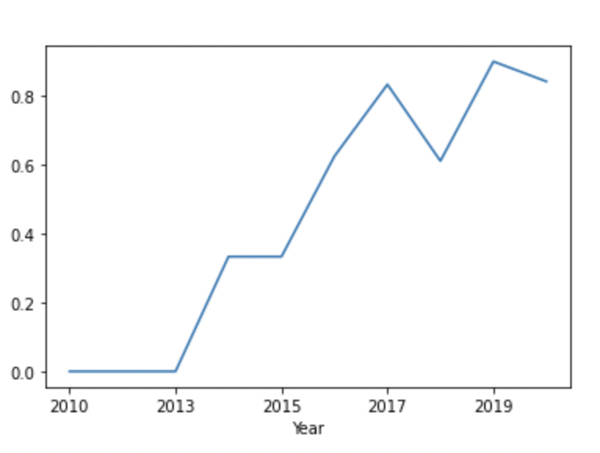
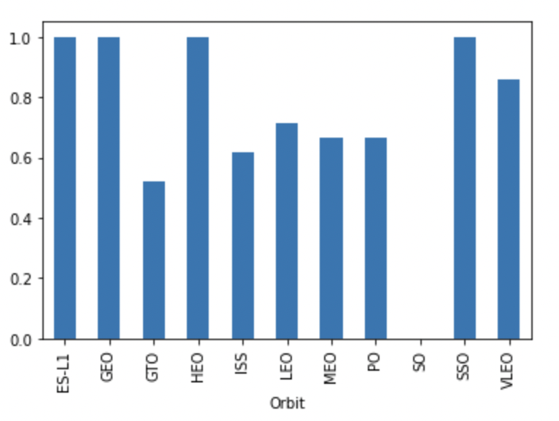
Results
Exploratory data analysis results
Line Plot :
Bar Chart :

Slide 18
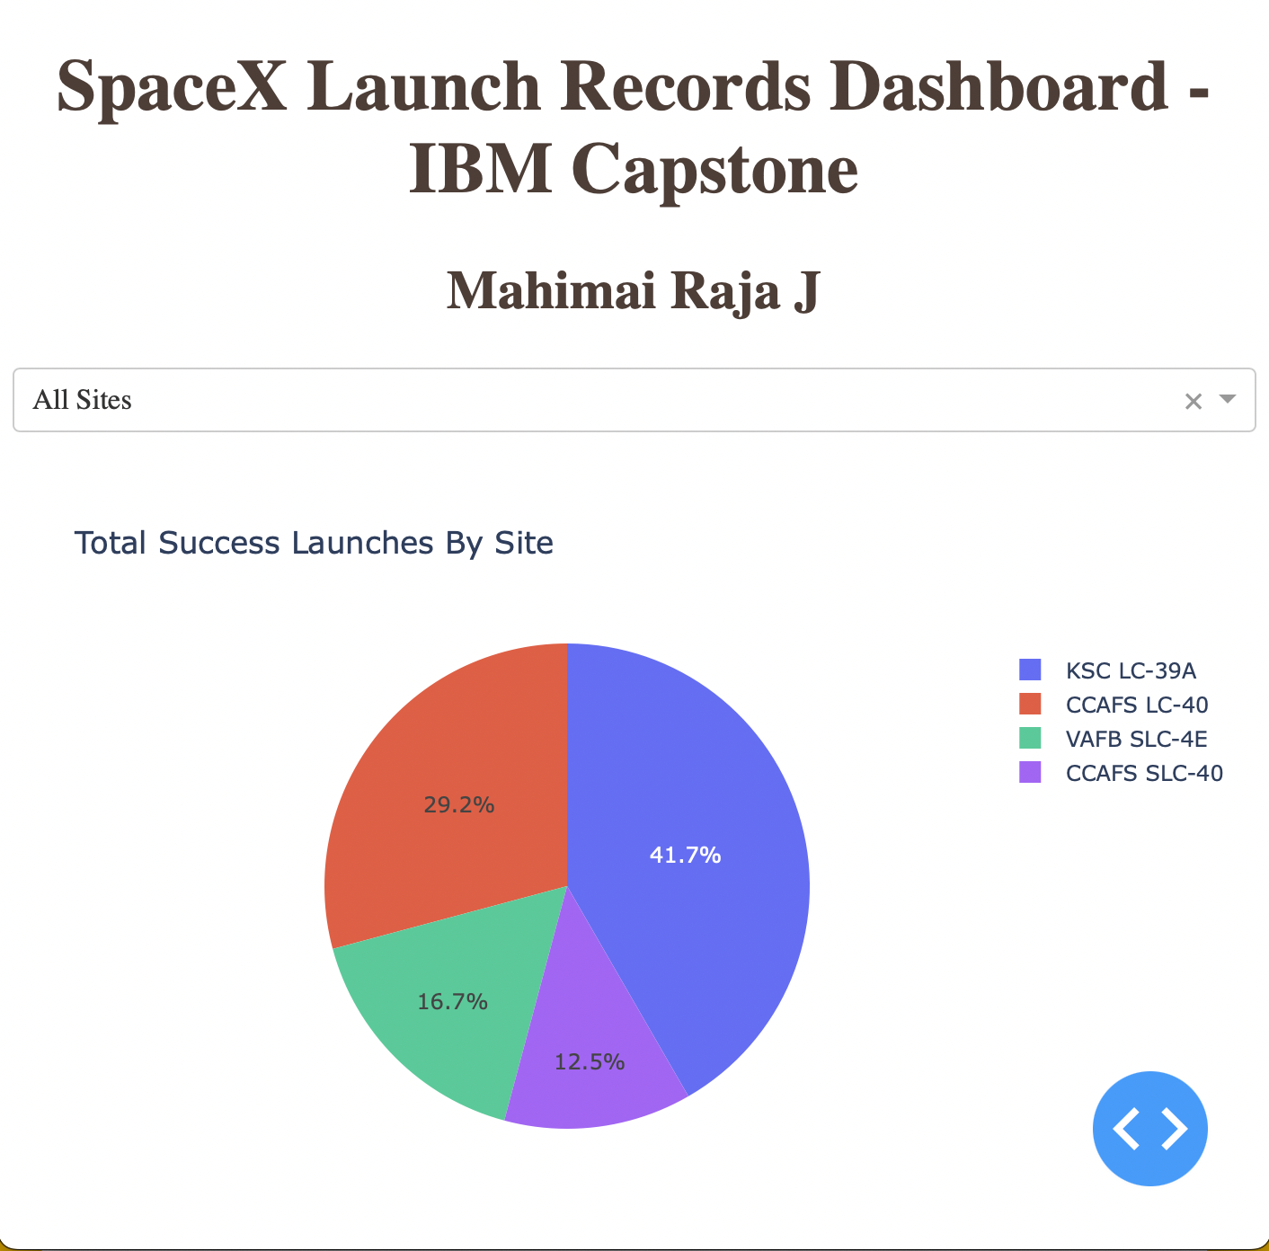
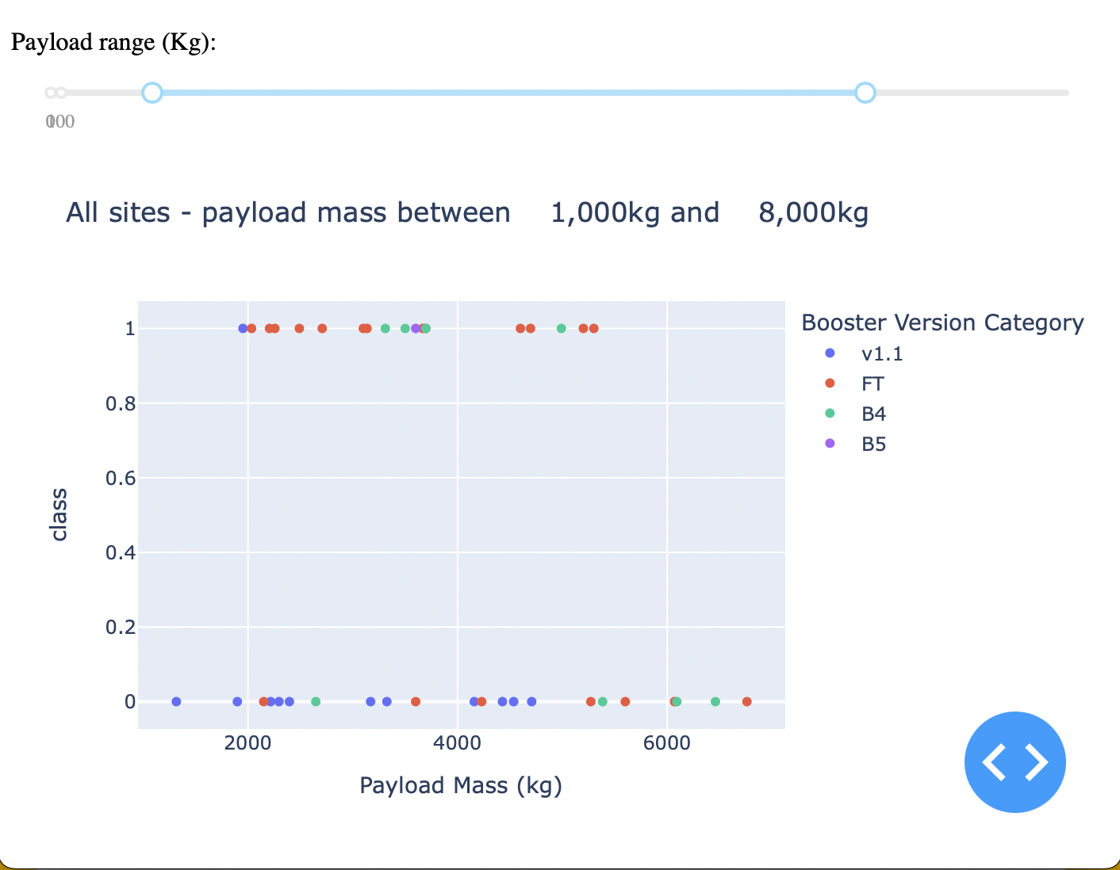
Results
Interactive analytics demo in screenshots
Pie Chart :
Scatter Plot

Slide 19
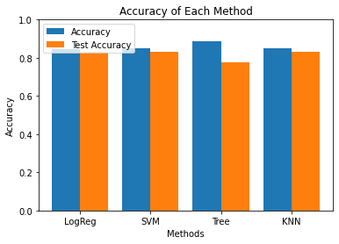
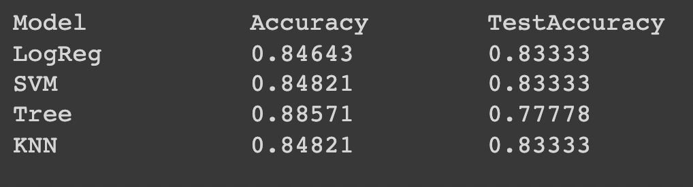
Results
Predictive analysis results
Comparative Analysis
Comparison Graph

Slide 20

Section 2

Slide 21
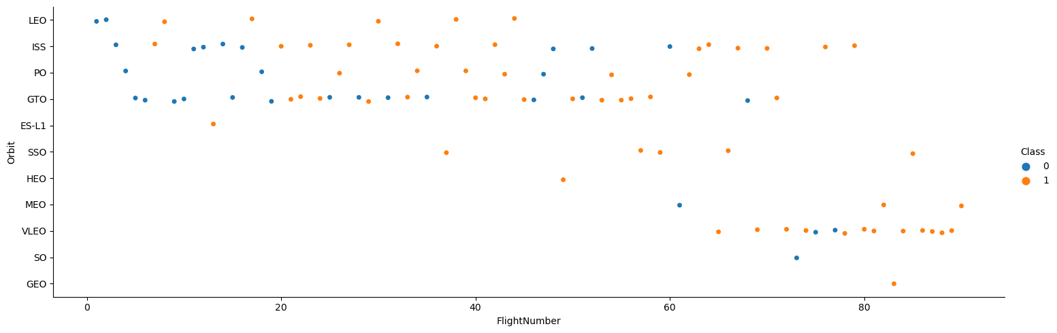
Flight Number vs. Launch Site
From the above graph we can understand that VLEO launch side has high success rate comparatively.

Slide 22
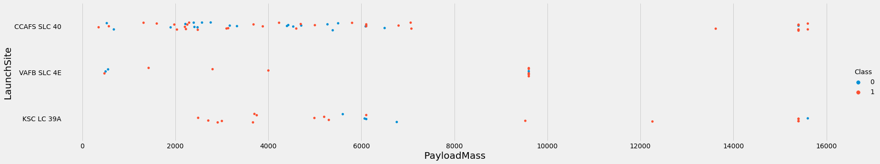
Payload vs. Launch Site
From the scatter plot we can understand most of the launch sites were used to launch low weight payloads and the payloads above 10,000 mass have a high success rate.

Slide 23
Success Rate vs. Orbit Type
From the above bar chart we can understand that the launch site ‘SO’ have zero success rate.

Slide 24
Flight Number vs. Orbit Type
From the above scatter plot we can understand that as the flight number increases the success rate is also more or less comparatively higher.

Slide 25
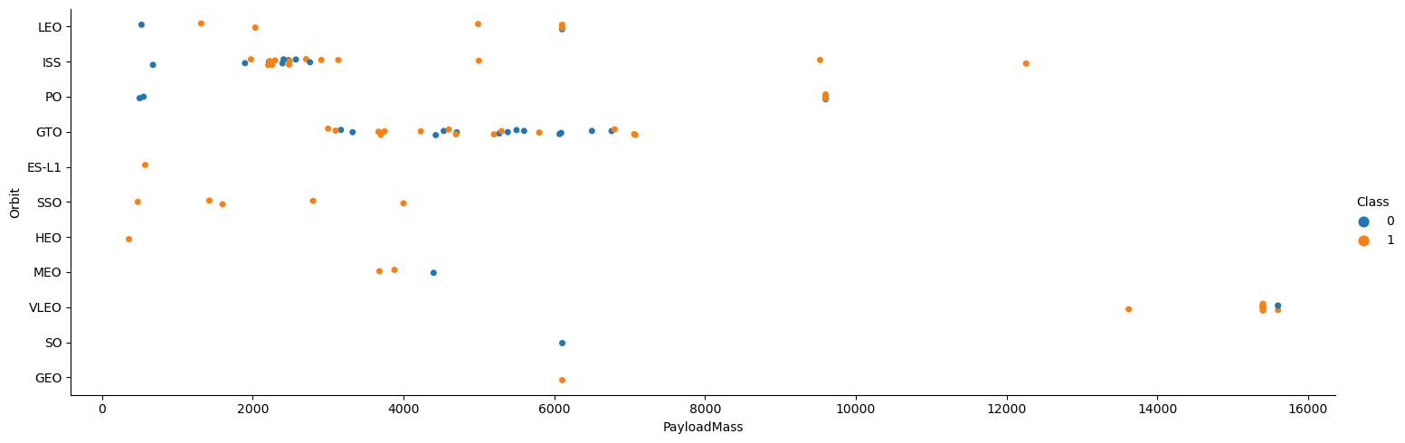
Payload vs. Orbit Type
From the above graph we can understand that most of the payload were of lower mass comparatively.

Slide 26
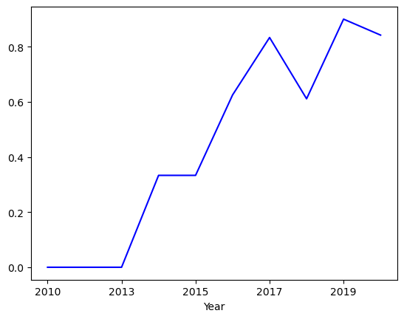
Launch Success Yearly Trend
From the above graph we can understand that the success rate is gradually increasing every year.

Slide 27
All Launch Site Names
launch_site
CCAFS LC-40
CCAFS SLC-40
KSC LC-39A
VAFB SLC-4E
sql SELECT DISTINCT launch_site from space01;
We can understand that there are four unique launch sites in the given dataset.

Slide 28
Launch Site Names Begin with 'CCA'
DATE | time__utc_ | booster_version | launch_site | payload | payload_mass__kg_ | orbit | customer | mission_outcome | landing__outcome
04-06-2010 | 18:45:00 | F9 v1.0 B0003 | CCAFS LC-40 | Dragon Spacecraft Qualification Unit | 0 | LEO | SpaceX | Success | Failure (parachute)
08-12-2010 | 15:43:00 | F9 v1.0 B0004 | CCAFS LC-40 | Dragon demo flight C1, two CubeSats, barrel of Brouere cheese | 0 | LEO (ISS) | NASA (COTS) NRO | Success | Failure (parachute)
22-05-2012 | 07:44:00 | F9 v1.0 B0005 | CCAFS LC-40 | Dragon demo flight C2 | 525 | LEO (ISS) | NASA (COTS) | Success | No attempt
08-10-2012 | 00:35:00 | F9 v1.0 B0006 | CCAFS LC-40 | SpaceX CRS-1 | 500 | LEO (ISS) | NASA (CRS) | Success | No attempt
01-03-2013 | 15:10:00 | F9 v1.0 B0007 | CCAFS LC-40 | SpaceX CRS-2 | 677 | LEO (ISS) | NASA (CRS) | Success | No attempt
sql SELECT * from space01 where launch_site LIKE ‘CCA%’ limit 5;
We can undertand that the launch site starts with cca are usually weight less.

Slide 29
Total Payload Mass
payload_mass45596
sql select sum(payload_mass__kg_) as Payload_Mass from SPACE01 where customer LIKE 'NASA (CRS)’;
The sum of all the payload mass is 45,596

Slide 30
Average Payload Mass by F9 v1.1
Average Mass
2928
sql select avg(payload_mass__kg_) from SPACE01 WHERE BOOSTER_VERSION = 'F9 v1.1’;
The average mass of all payload is 2928.

Slide 31
First Successful Ground Landing Date
First Success
01-05-2017
sql select min(DATE) from SPACE01 where landing__outcome LIKE 'Success (ground pad)’;
Only from 2017 the ground pad launches were success

Slide 32
Successful Drone Ship Landing with Payload between 4000 and 6000
booster_version
F9 FT B1022
F9 FT B1026
F9 FT B1021.2
F9 FT B1031.2
sql select booster_version from SPACE01 where landing__outcome LIKE 'Success (drone ship)' and PAYLOAD_MASS__KG_ BETWEEN 4000 AND 6000
There were only four booster versions between 4000 to 6000 mass.

Slide 33
Total Number of Successful and Failure Mission Outcomes
mission_outcome | total_number
Failure (in flight) | 1
Success | 99
Success (payload status unclear) | 1
sql SELECT MISSION_OUTCOME, COUNT(*) AS Total_Number FROM SPACE01 GROUP BY MISSION_OUTCOME ORDER BY MISSION_OUTCOME;
The number of success record is higher in the given dataset.

Slide 34
Boosters Carried Maximum Payload
booster_version
F9 B5B1048.4
F9 B5B1049.4
F9 B5B1051.3
F9 B5B1056.4
F9 B5B1048.5
F9 B5B1051.4
F9 B5B1049.5
F9 B5B1060.2
F9 B5B1058.3
F9 B5B1051.6
F9 B5B1060.3
F9 B5 B1049.7
sql select booster_version from SPACE01 where PAYLOAD_MASS__KG_ = (select max(PAYLOAD_MASS__KG_) from SPACE01);
There were12 booster version with maximum weight.

Slide 35
2015 Launch Records
booster_version launch_site
F9 v1.1 B1012 CCAFS LC-40 F9 v1.1 B1015 CCAFS LC-40
sql select booster_version, launch_site from SPACE01 WHERE LANDING__OUTCOME = 'Failure (drone ship)' and DATE LIKE '%2015’;
In2015 there were two booster version led to failure by drone ship.

Slide 36
Rank Landing Outcomes Between 2010-06-04 and 2017-03-20
landing__outcome Total
No attempt 10
Failure (drone ship) 5
Success (drone ship) 5
Controlled (ocean) 3
Success (ground pad) 3
Failure (parachute) 2
Uncontrolled (ocean) 2
Precluded (drone ship) 1
sql SELECT LANDING__OUTCOME, COUNT(*) AS QTY FROM SPACE01 WHERE DATE BETWEEN '2010-06-04' AND '2017-03-20' GROUP BY LANDING__OUTCOME order by LANDING__OUTCOME;
No attempt is higher between 2004 and 2020.

Slide 37

Section 3

Slide 38
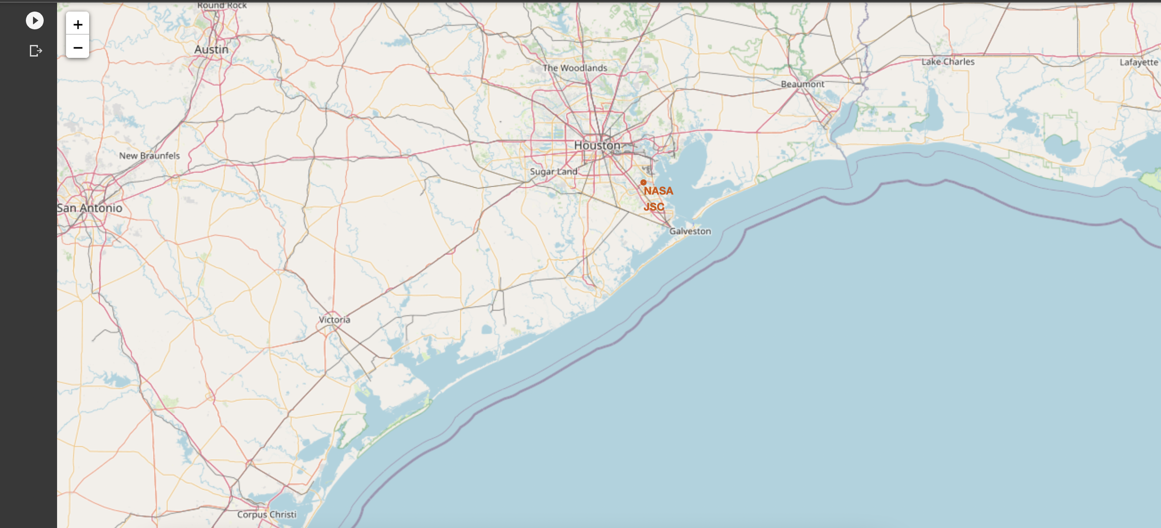
NASA Johnson Space Center
Here we used circle and marked to specify the NASA Johnson Space Center.

Slide 39
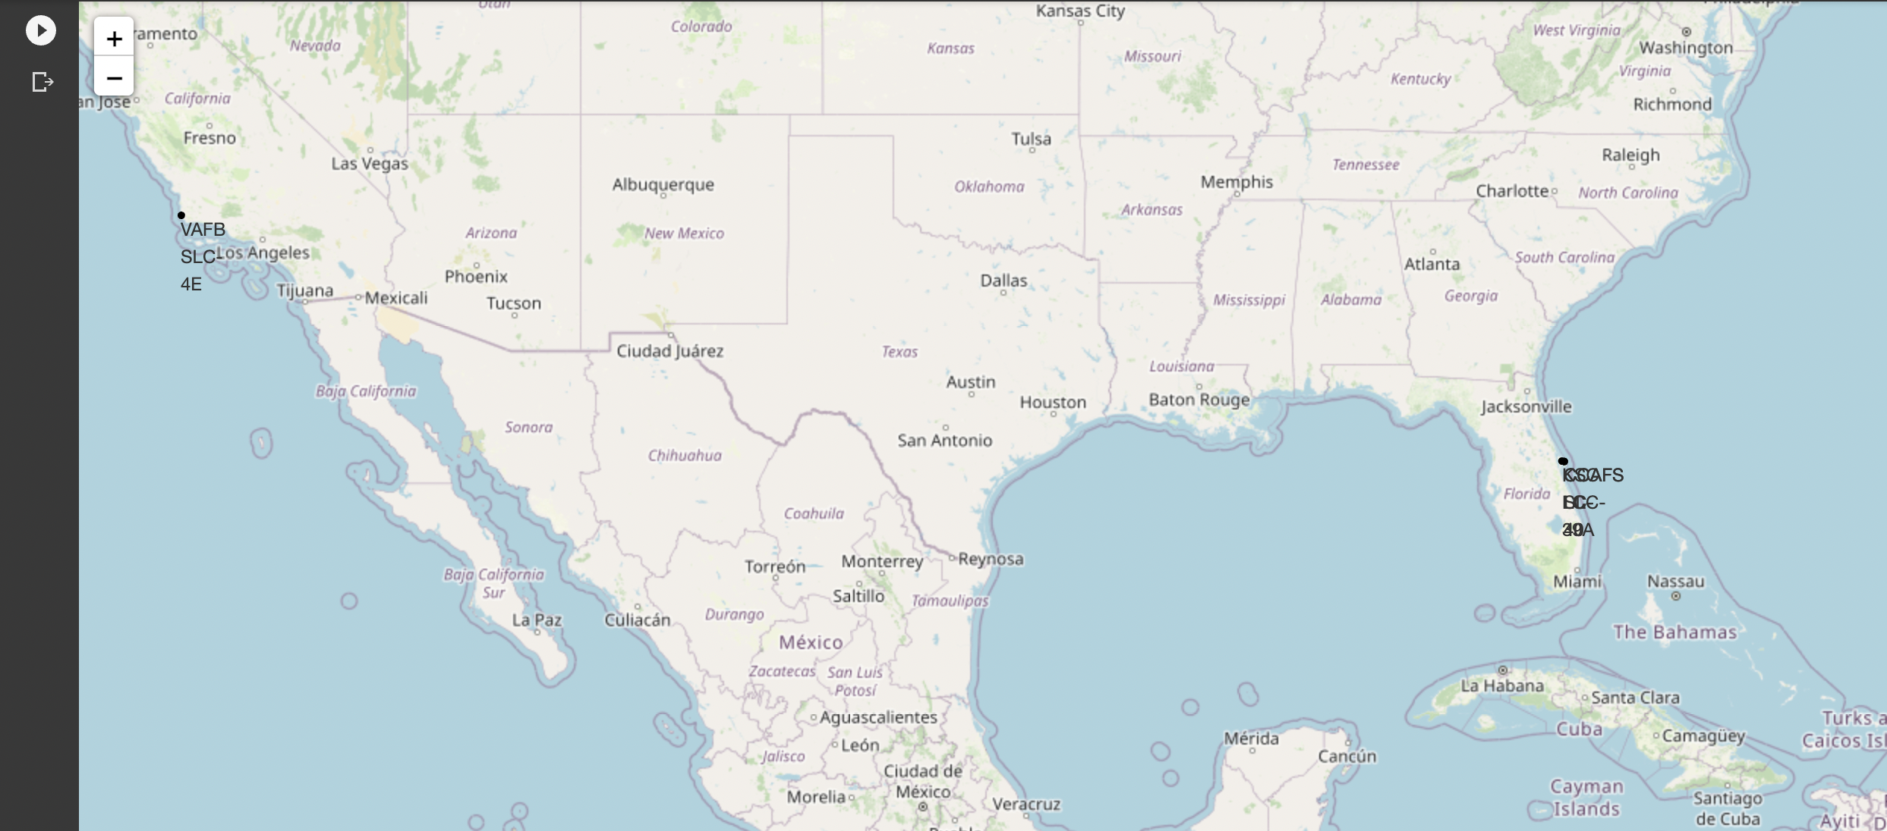
Launch Sites
Here we have used circle and marker to specify all the unique launch sites.

Slide 40
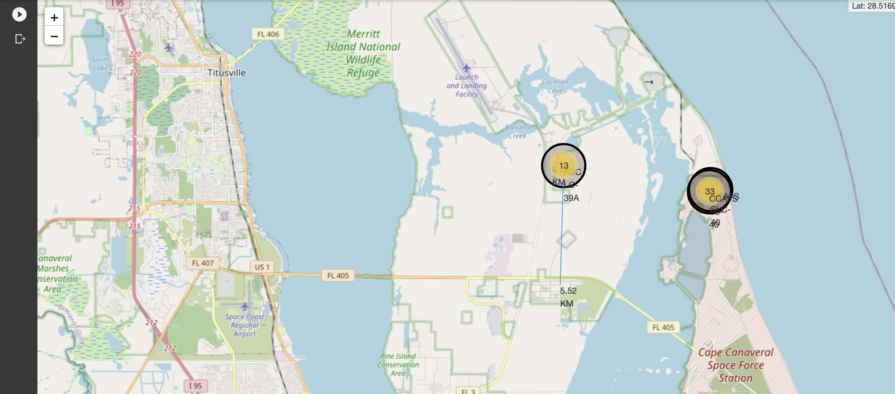
Distance to closest city
Here we have clusters the nearby launch sites and used distance marker to calculate the distance to nearest city, railway and highway

Slide 41

Section 4

Slide 42
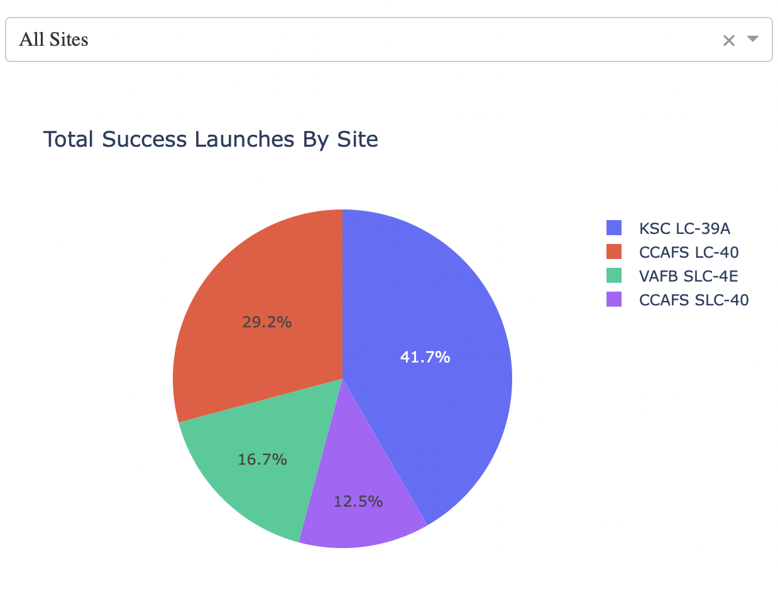
Success Rate – Pie Chart
From the above pie chart we can understand that KSC LC-39A has the higest success rate

Slide 43
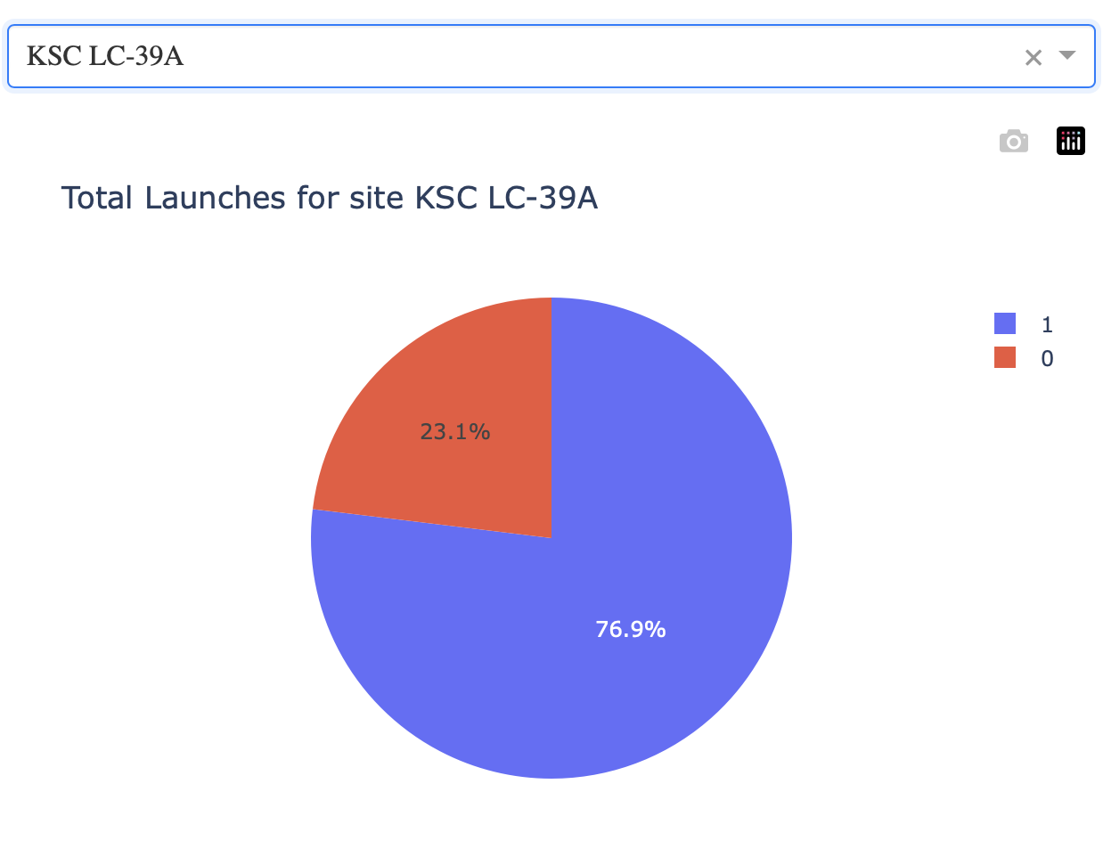
Success Ration - KSC-LC-39A
From the above pie chart we can understand that the failure rate is comparatively lesser.

Slide 44
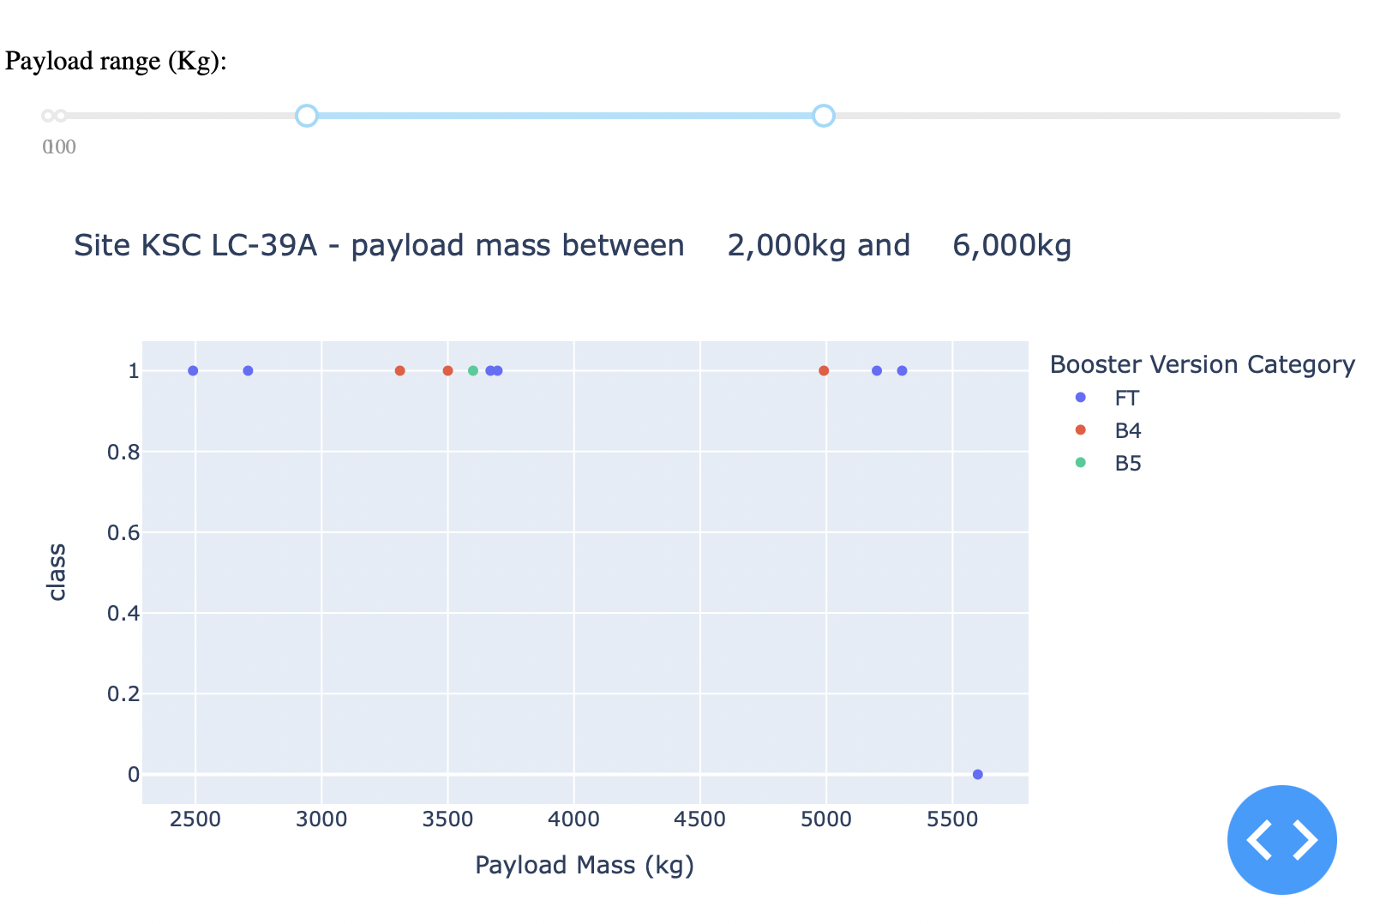
Payload on Success – Scatter plot
From the above scatter plot we can understand that most of the successful payloads we lesser that 6000 unit mass.

Slide 45

Section 5

Slide 46
Classification Accuracy
Here we have decision tree classifier with the highest accuracy but, It lacks in generalization. So we can go with the second best model logistic regression.

Slide 47
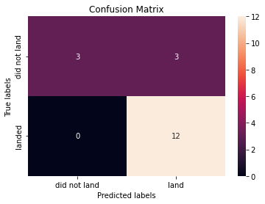
Confusion Matrix – Logistic Regression
By looking into the confusion matrix we can understand that our logistic regression model has only few wrong predictions. And the overall performance is good.

Slide 48
Conclusions
Orbit ES-L1, GEO, HEO, SSO has highest success rate.
Success rates for spaceX launches has been increasing relatively with time and it looks like soon they will reach the required targer.
Most of the successful payloads were lesser than 8000 unit mass.
Logistic Regression is the best of the models that I have trained with the given dataset.

Slide 49
Appendix
The model then converted into joblib file format and then hosted in ‘Pythion everywhere’ using flask framework.
The live interactive dashboard is hosted using plotly dash and flask.

Slide 50


